Slide 1
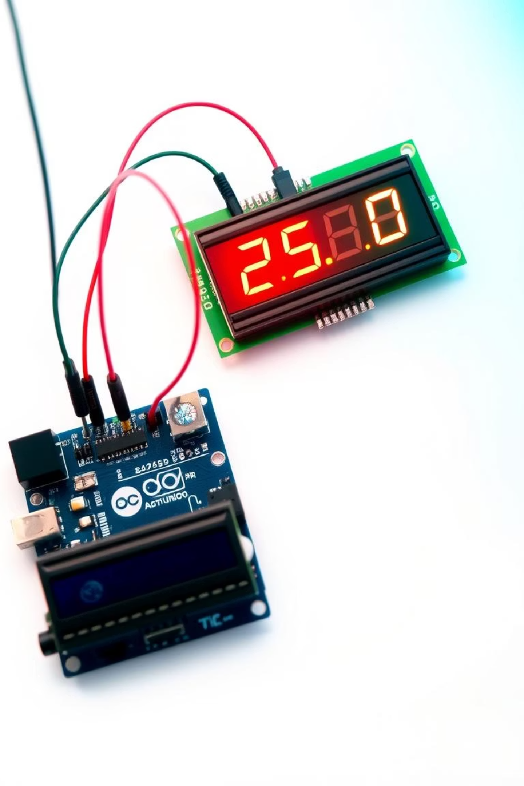
Arduino-Powered Digital Thermometer: Precision Temperature Monitoring
Welcome to the exciting world of DIY temperature sensing using microcontrollers! This presentation will guide you through building a real-time, digital temperature display with Arduino – an accessible, accurate, and versatile project suitable for all skill levels.

Slide 2
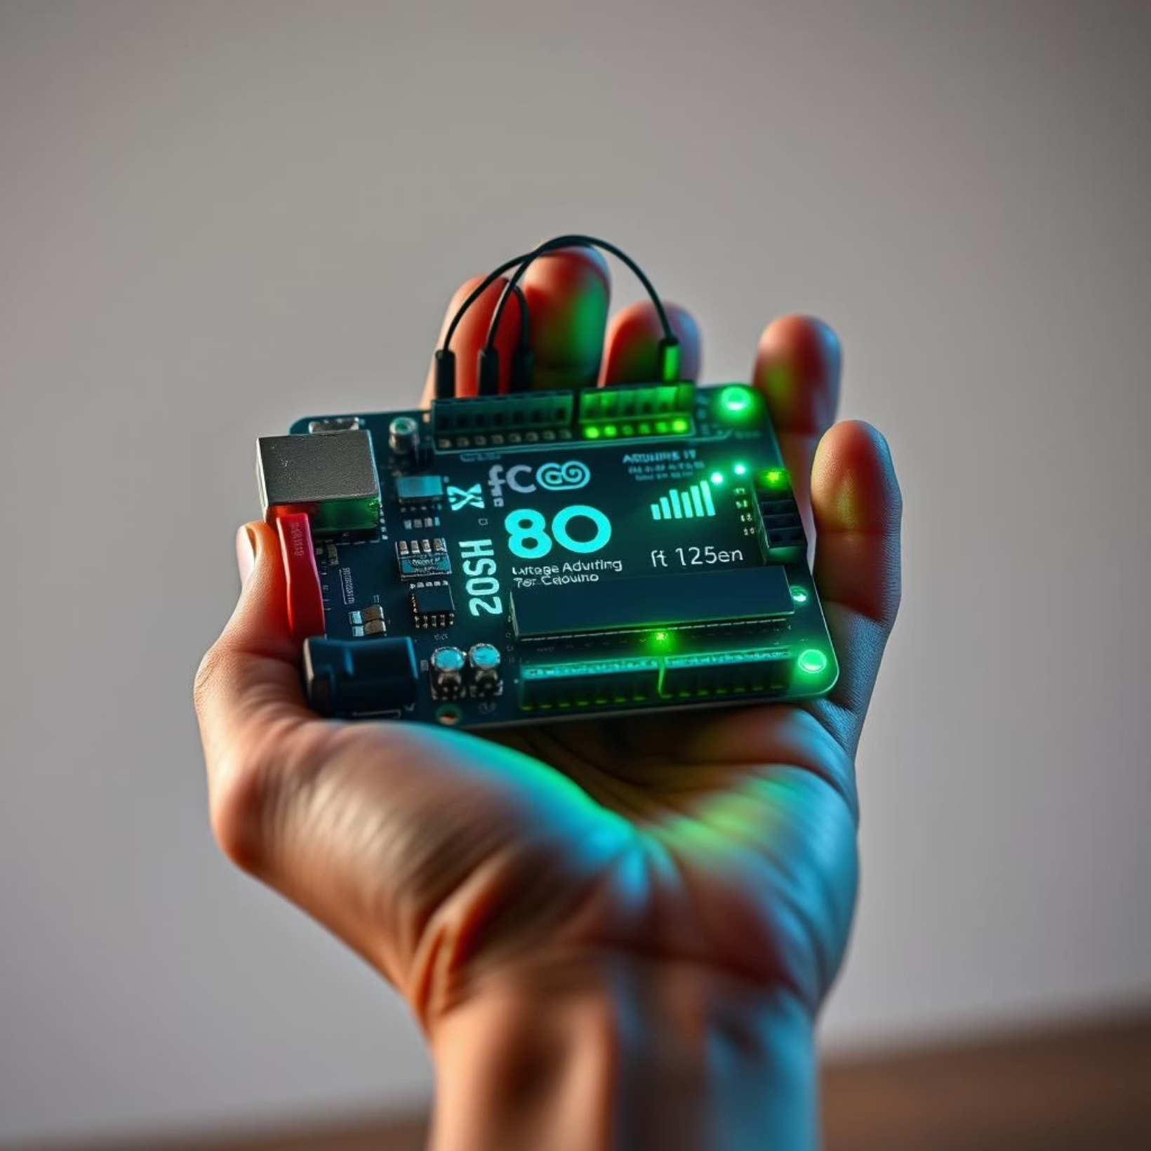
Introduction: Why Build Your Own?
Digital thermometers precisely measure temperature, and building your own offers unique advantages. Arduino, an open-source platform with a low-cost Uno board (typically $5-$25), provides extensive community support, making it ideal for beginners and experienced makers alike.
This project offers significant educational value, allowing you to learn electronics, programming, and sensor integration firsthand. Beyond learning, it's practical: you can customize features unavailable in commercial alternatives, tailoring the thermometer to your specific needs.

Slide 3

Core Components: What You'll Need
Arduino Uno Board
LM35 Temperature Sensor
Microcontroller with ATmega328P chip, featuring 14 digital I/O pins and 6 analog inputs for versatile connectivity.
Provides a linear analog output (10mV/°C), with a range of -55°C to 150°C and ±0.5°C accuracy at 25°C.
16x2 LCD Display
Breadboard & Jumper Wires
A standard character display, often equipped with an I2C module to simplify wiring to just two data pins.
Essential for prototyping, enabling secure and flexible connections between all components.

Slide 4
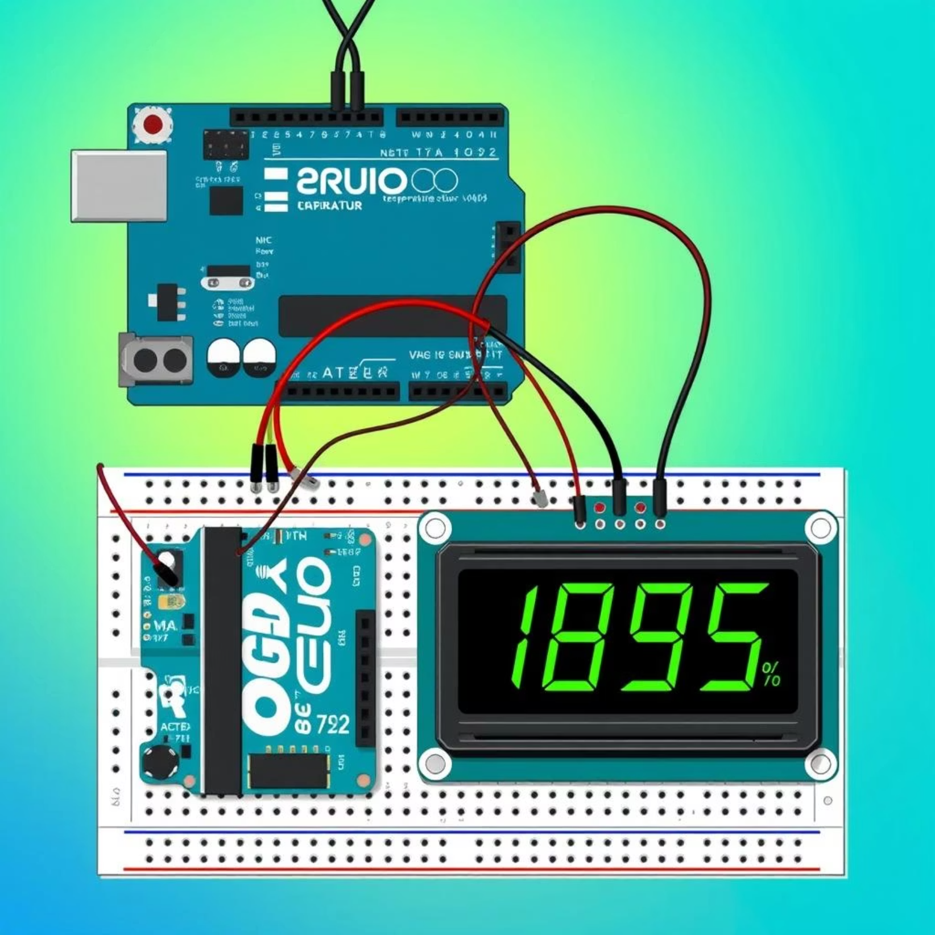
Hardware Setup: Connecting the Circuit
Wiring the LM35 sensor is straightforward: connect its VCC pin to Arduino's 5V, GND to GND, and the Vout (output pin) to Arduino's Analog Pin A0. For the 16x2 LCD with an I2C module, connect the SDA pin to Arduino Analog Pin A4 and the SCL pin to Arduino Analog Pin A5. Ensure VCC goes to 5V and GND to GND.
The Arduino itself can be powered conveniently via a USB cable from your computer or through an external 9V adapter for standalone operation. This setup creates a clear and functional circuit for your digital thermometer.

Slide 5

Software Logic: The Arduino Sketch
Required Libraries
Include the `LiquidCrystal_I2C.h` library to enable seamless communication with your LCD display.
Sensor Reading
Utilize `analogRead(A0)` to convert the LM35's analog voltage (0-5V) into a digital value ranging from 0 to 1023.
Temperature Conversion
Convert the raw sensor value to voltage (`voltage = (sensorValue * 5.0) / 1024.0;`) and then to Celsius (`tempC = voltage * 100.0;`).
LCD Display & Loop
Initialize the LCD, set the cursor, and use `lcd.print()` to show the temperature. The `loop()` function continuously reads and updates the display.

Slide 6
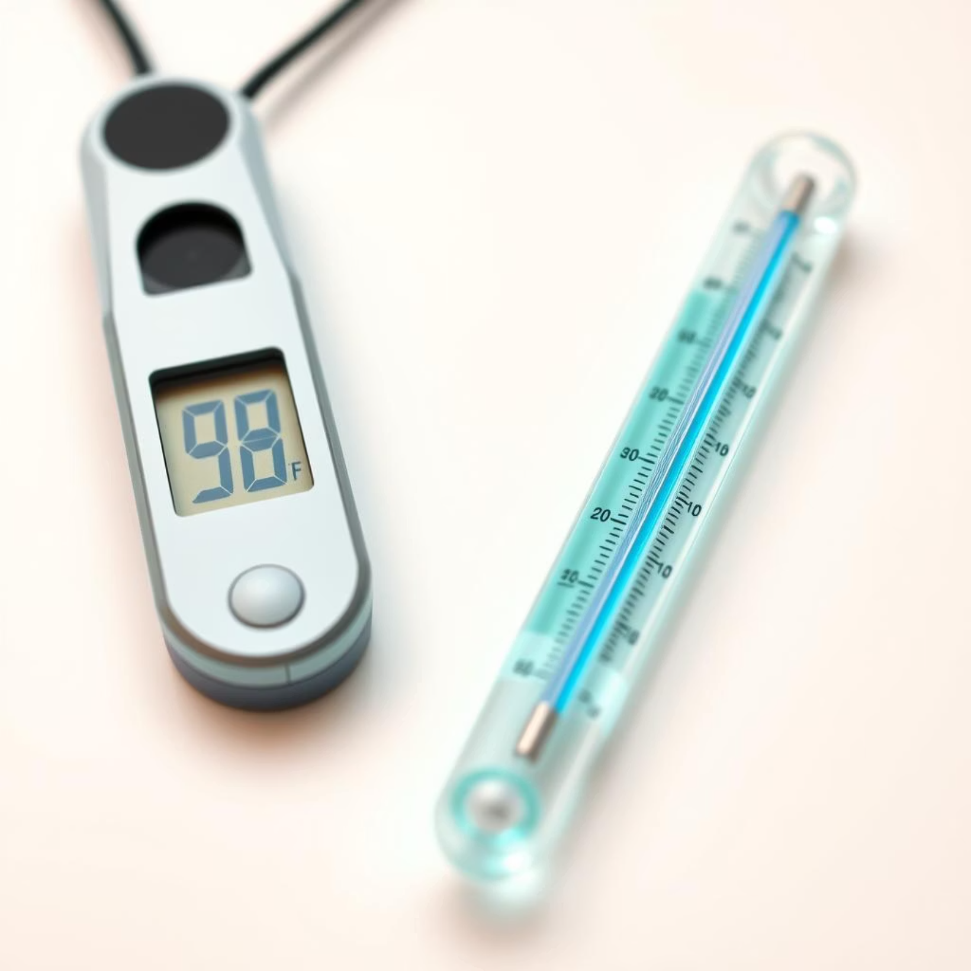
Accuracy, Calibration & Considerations
The LM35 boasts a specified ±0.5°C accuracy at 25°C, making it reliable for most basic applications. For enhanced precision, compare your readings with a trusted reference thermometer and apply a small offset in your code, such as `tempC = tempC + 0.2;`, if needed.
To reduce electrical noise and stabilize readings, consider adding a 0.1uF capacitor across the LM35's output. Environmental factors like airflow, proximity to heat sources, and the sensor's placement can affect readings, so choose your location wisely. Adjusting the delay in your loop function (e.g., `delay(1000);` for 1-second updates) allows you to control the display's refresh rate.

Slide 7





Key Features & Advantages
Real-time Data
Instantaneous temperature display that updates continuously.
Customizable Alerts
Easily program LED warnings or buzzers for temperature thresholds.
Low Cost
Total component cost typically under $30-$40, very affordable.
Learning Platform
Ideal for grasping electronics, coding, and sensor integration.
Portability
Can be battery-powered for mobile and remote applications.

Slide 8
Practical Applications & Use Cases
Home Environment Monitoring
Track room temperature for comfort or HVAC optimization.
Hobbyist Projects
Monitor conditions in terrariums, greenhouses, or pet enclosures.
Educational Demonstrations
Engaging STEM project for schools, science fairs, and workshops.
DIY Weather Stations
Integrate with other sensors (humidity, pressure) for a comprehensive setup.
Temperature Logging
Extend with an SD card module to record data over time for analysis.

Slide 9
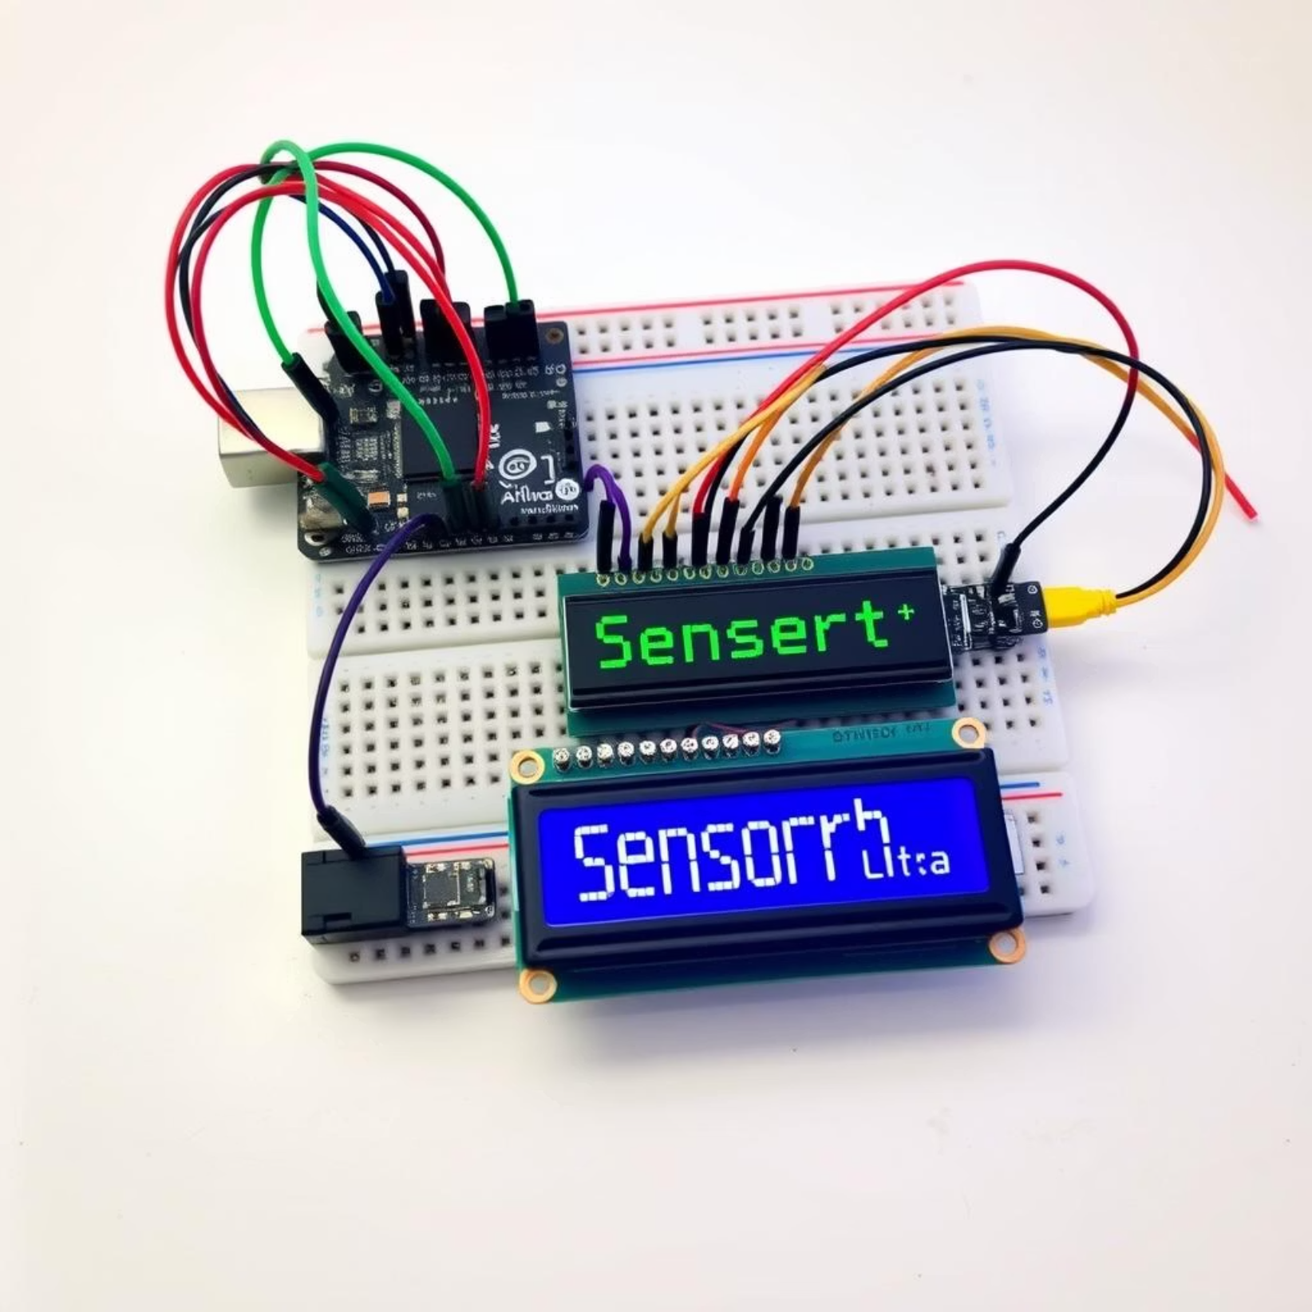
Enhancements & Future Scope
Wireless Connectivity
Integrate an ESP8266 or ESP32 Wi-Fi module for remote monitoring via web server or mobile app.
Multiple Sensors
Add DHT11/DHT22 for humidity, or multiple LM35s to monitor different zones simultaneously.
Advanced Display
Upgrade to an OLED display for graphical representation or more detailed information.

Slide 10

Conclusion: Unlock the World of IoT
In recap, this presentation has guided you through building a simple, versatile, and precise DIY digital thermometer using Arduino. This project demystifies electronics, programming, and sensor-based applications, serving as a foundational step for countless IoT and home automation endeavors. We encourage you to start your own Arduino journey today and bring your innovative ideas to life!

